Slide 1





On the Naturalness of Proofs
Vincent J. Hellendoorn, Premkumar T. Devanbu @ UC Davis
and Mohammad Amin Alipour @ University of Houston
Grant #1414172
Exploiting the Naturalness
of Software

Slide 2
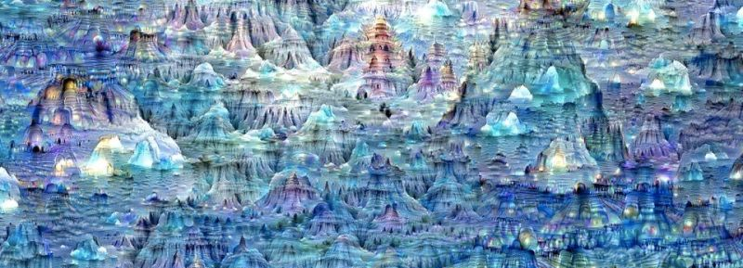
Naturalness
Patterns to the Chaos
https://ai.googleblog.com/2015/06/inceptionism-going-deeper-into-neural.html

Slide 3
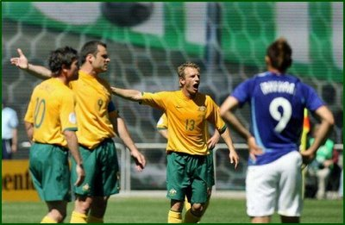
Naturalness
Patterns to the Chaos

Slide 4
Naturalness
Patterns to the Chaos
To be or not to __?
Notes:
Programming Languages

Slide 5
Proofs
Capturing Certainty

Slide 6
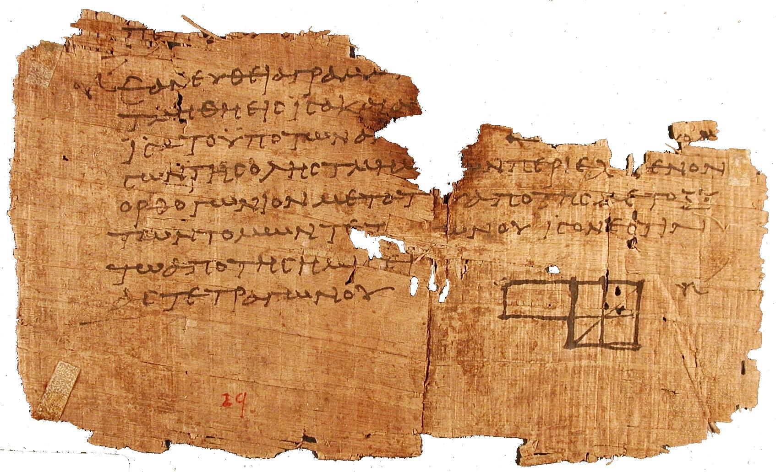
Proofs
Capturing Certainty

Slide 7
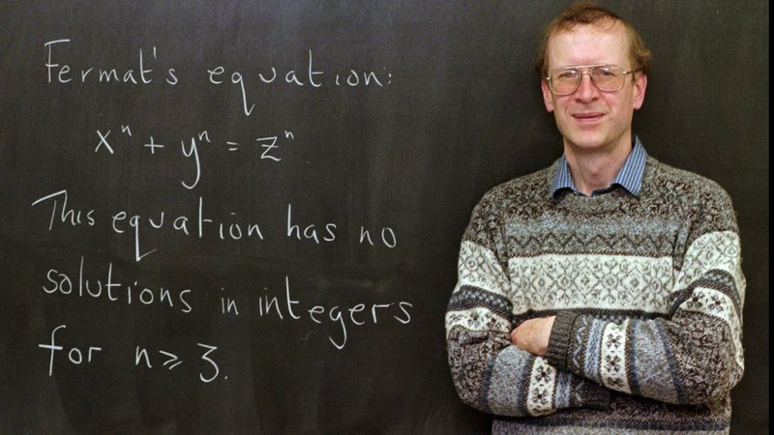
Proofs
Capturing Certainty
https://media.npr.org/assets/img/2016/03/17/ap_9801060667_wide-7181f391d24454a1662c7edd0077a48197f4ffb4-s800-c85.jpg

Slide 8
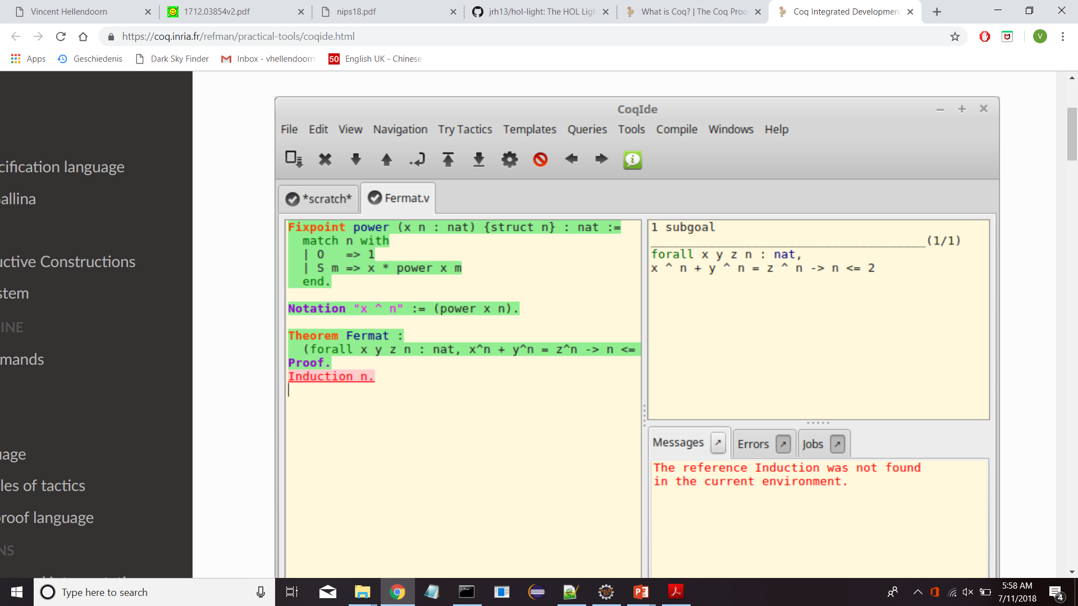
Proofs
Capturing Certainty
https://coq.inria.fr/refman/practical-tools/coqide.html
Notes:
formal specifications, programs & proofs that programs comply to their specifications

Slide 9
Opposites?
We are the ones
Writing the Proofs

Slide 10
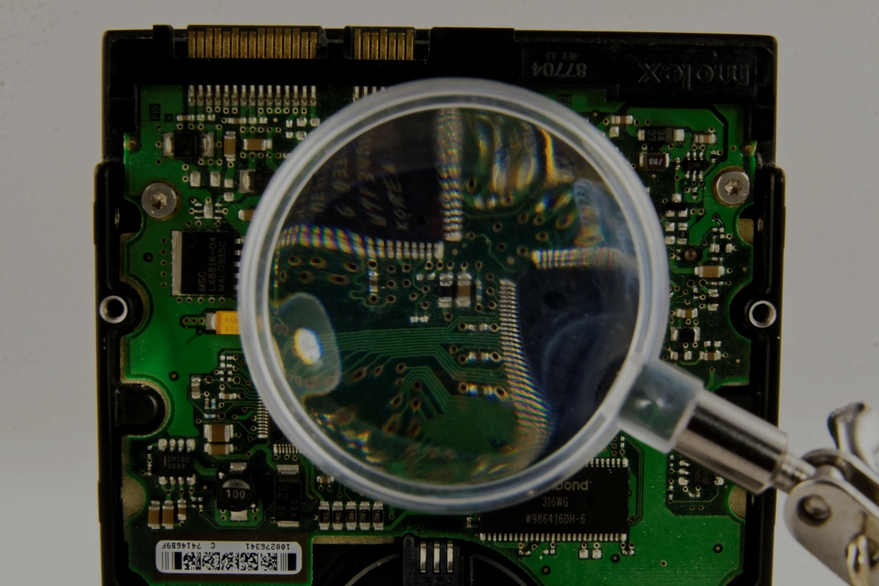
The Details

Slide 11
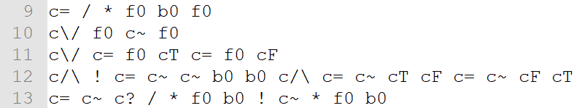
The Proofs
Higher Order Logic
Kernel Traces
http://cl-informatik.uibk.ac.at/cek/holstep/
Notes:
HOL Light

Slide 12

The Proofs
Coq
Notes:
Proof development system
CompCert C compiler

Slide 13

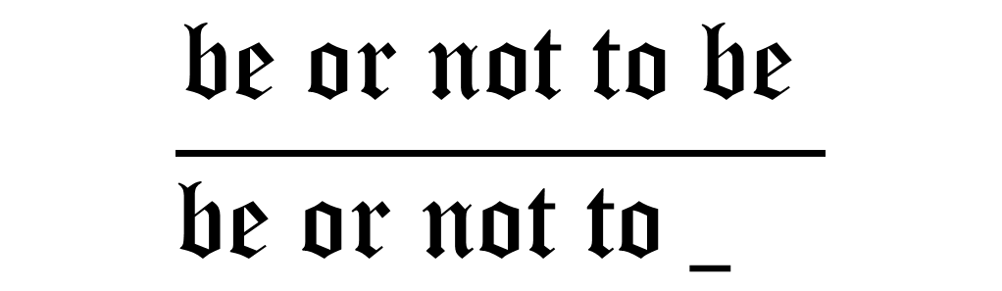
The Models
$$\frac{\text{be} \text{or} \text{not} \text{to} \text{be} }{\text{be} \text{or} \text{not} \text{to} _ }$$
https://cdn-images-1.medium.com/max/1600/1*NKhwsOYNUT5xU7Pyf6Znhg.png

Slide 14
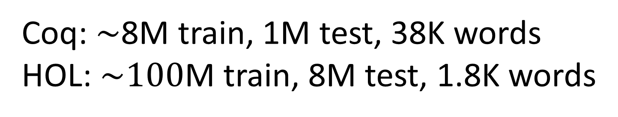
Results
Coq: $\sim$8M train, 1M test, 38K words
HOL: $\sim 100$M train, 8M test, 1.8K words

Slide 15
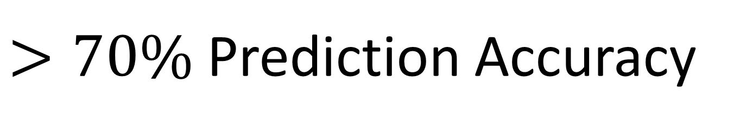
Results
$>70\%$ Prediction Accuracy
RNNs are Competitive
Highly Local

Slide 16

Vision

Slide 17


Vision
Short-term
Completion
Debugging
Long-term
Proof synthesis?
Proof Discovery?
Contact: vhellendoorn.github.io $⋅$ vhellendoorn@ucdavis.edu
Notes:
Excited

